Slide 1
Building ARM IaaS Application Environment
Zaid Al-Safadi
Software Engineer/Web Solutions Architect

Slide 2
Agenda
Azure Resource Manager Overview
Virtual Networks
Virtual Machines
Resource Manager Template Deployment

Slide 3
Azure Resource Manager

Slide 4
Azure Resource Manager & Resource Groups
Manage resources as a single unit
Role based access control (RBAC) on groups or resources
Billing integrated tagging on groups or resources
RESOU
R
CE G
R
OUP

Slide 5



Azure Resource Manager (ARM)
This slide could use build/animation. It builds from top to bottom. Azure/Commandline/Visual studio all hit the API to interact with resource manager groups which in turn interact with the different rest points. The link https://azure.microsoft.com/en-us/documentation/articles/virtual-machines-azure-resource-manager-architecture/
explains what this slide is supposed to get across.
RESOURCE MANAGER
Consistent management layer
Tools
SERVICE MANAGEMENT API
Microsoft Azure
Command line
Visual Studio
ADFS
AAD
Contoso
Curated extensions
Cloud
On-premises
RESOURCE PROVIDER CONRACT
Provider rest points
DB

Slide 6
Virtual Networks

Slide 7
Azure Virtual Networks
A protected private virtual network in cloud
Extend enterprise networks into Azure
Cross-premises connectivity

Slide 8
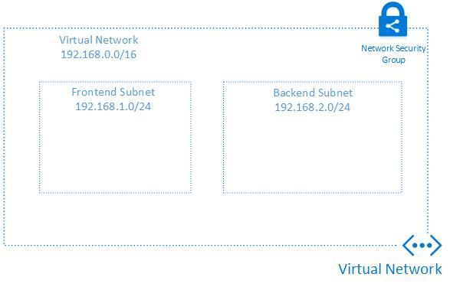

Slide 9
Demo: Build Virtual Network
http://zaidsafadi.com/blog/developing-with-arm-iaas/

Slide 10
Virtual Machines

Slide 11


Provisioning VM
Getting Started
Select Image and VM Size
New Disk Persisted in Storage
Windows Server
Management Portal
Boot VM from New Disk
Linux
>_
General Purpose
Basic
Standard
Optimized Compute
Performance Optimized
Network Optimized
Scripting
(Windows, Linux and Mac)
Cloud
REST API

Slide 12

















VM Gallery
A collection of prebuilt images for various workloads
Windows Server 2012 R2
Ubuntu Server 14.04 LTS
CentOS 6.5
SUSE Linux
Enterprise Server
openSUSE 13.1
Oracle Linux 6.4.0.0.0
SQL Server 2014 Standard
Oracle Database 11g R2
SharePoint Server Farm
Microsoft Dynamics
GP 2013
Zulu 8
BizTalk Server 2013
SAP HANA
Developer Edition
Puppet Enterprise 3.2.3
Barracuda Web Application
Oracle WebLogic
Server 12.1.2
Visual Studio Ultimate 2013
Windows 8.1 Enterprise

Slide 13
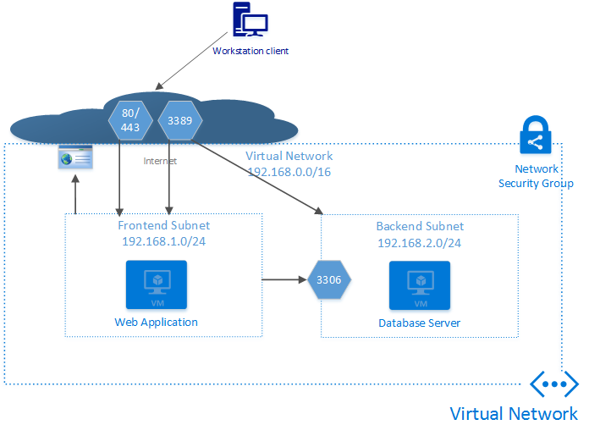
Architecture

Slide 14
Demo: Managing VMs using Azure portal
http://zaidsafadi.com/blog/developing-with-arm-iaas-part-2/

Slide 15
ARM Template Deployment

Slide 16
Resource Manager example
Classic model (v1)
Resource Manager (v2)
Cloud service
Resource group
Load balanced
endpoint with IP address
Back-end pool (NICs)
VM with IP address
Storage account
VM
NIC
VM IP address
VNet
Load Balancer
LB IP address
Disk (blob)
Subnet
Reference
Reference
Reference
Storage account
Virtual network
Reference
Storage account
Virtual network
Depends on
Reference
Disk (blob)
Subnet-1
Network Security Group ACLS
(deployed to VM, NIC, or Subnet)

Slide 17
Azure Resource Manager templates
ARM templates can:
Simplify deployment
Simplify roll-back
Provide cross-resource configuration and update support
Be used as a learning tool to build to suit
Azure templates are:
Source file, checked-in
Specifies resources and dependencies (VMs, websites, DBs) and connections (configuration, LB sets)
Configurable parameters for input/output
ARM template
SQL-A website
Repeatable configuration
Configuration→ Resource Group
[SQL CONFIG] VM (2x)
Depends on SQL
Depends on SQL
DEPENDS ON SQL
SQL-A
Website
Virtual Machines
DB
SQL configuration

Slide 18
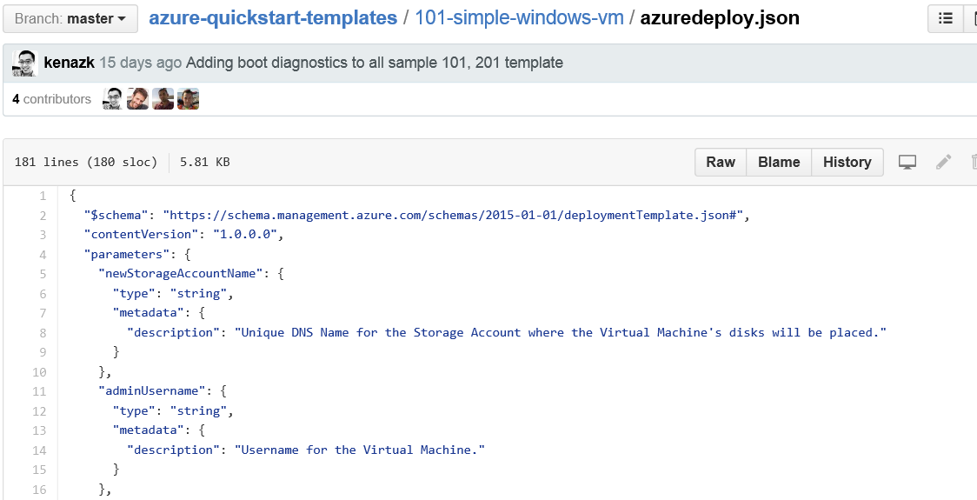
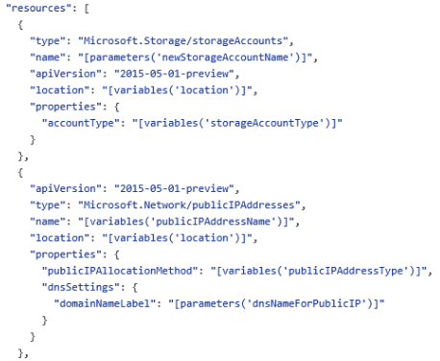
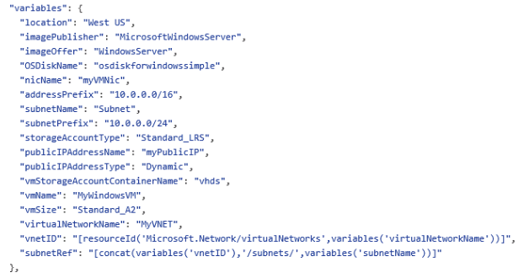
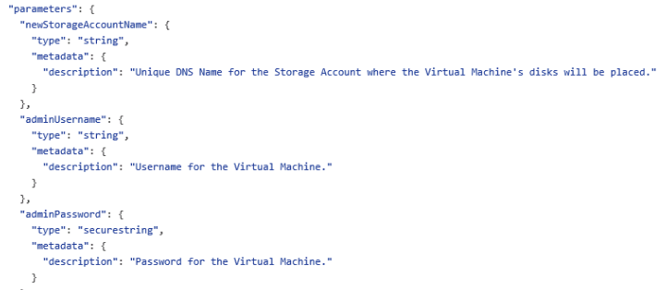
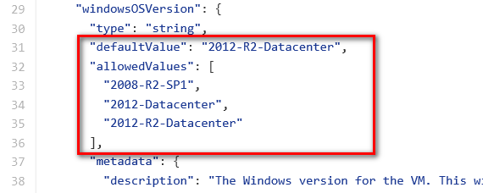
JSON files—simpler than they look Schema, content version, parameters, variables, resources, and outputs

Slide 19
Tools to help manage templates
GitHub
Visual Studio 2015/Code
NotePad/NotePad++

Slide 20
GIT
A widely used version control system for software development
A distributed revision control system with an emphasis on speed, data integrity, and support for distributed, non-linear workflows
A full-fledged repository with complete history and full version-tracking capabilities, independent of network access or a central server

Slide 21
GitHub
https://github.com
The largest code host on the planet with over 27.6 million repositories
Every repository comes with the same powerful tools
Tools are open to the community for public projects and secure for private projects
Allows for creation of a GIT Desktop and cloned repository

Slide 22
Visual Studio 2015/Code integration with GIT
Open your team repository in Visual Studio
Clone your repository
Create a new app
Confirm your settings and add the app
Snapshot (commit) your code
Pull changes from your team
Push your local commits to the server

Slide 23
Demo: Visual Studio template deployment
http://zaidsafadi.com/blog/developing-with-arm-templates-part-3/

